Slide 1
Lens and propagation of uncertainty

Slide 2
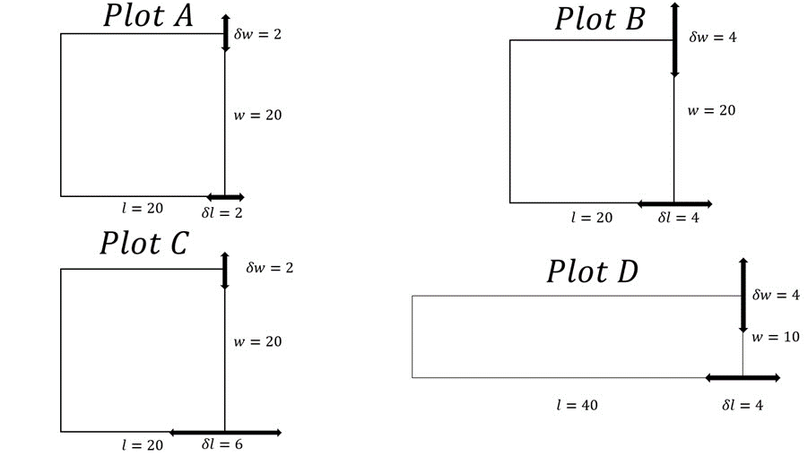
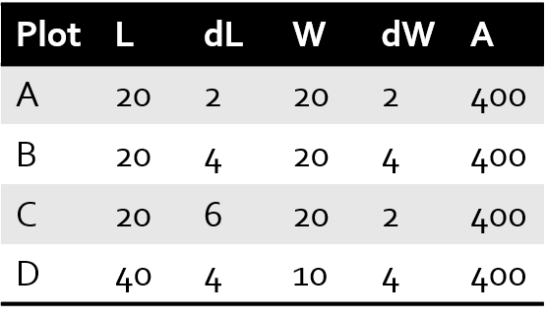
Prelab on uncertainty
So, how do we determine dA?

Slide 3
Prelab on uncertainty
First go at it: A ± dA = (L ± dL) ∙ (W ± dW)
A ± dA = LW ± LdW ± WdL + dLdW
This feels uncomfortable
Just as likely to cancel as to add!
dL*dW | First Guess
4 | 84
16 | 176
12 | 172
16 | 216

Slide 4
Prelab on uncertainty
Second go at it: A = L ∙ W ; dA is half the range between (L-dL) ∙ (W-dW) and (L+dL) ∙ (W+dW)
dL*dW | First Guess | Second Guess
4 | 84 | 80
16 | 176 | 160
12 | 172 | 160
16 | 216 | 200

Slide 5

Prelab on uncertainty
Third go at it: A = L ∙ W ; dA is sum of percent uncertain for each term
$\frac{dA}{A}= \frac{dL}{L}+\frac{dW}{W}$
dL*dW | First Guess | Second Guess | Third Guess
4 | 84 | 80 | 80
16 | 176 | 160 | 160
12 | 172 | 160 | 160
16 | 216 | 200 | 200

Slide 6
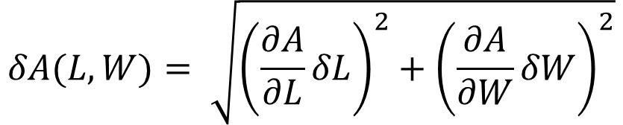
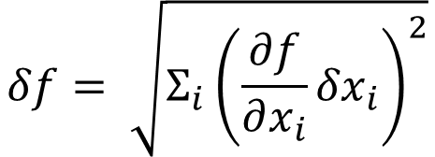
Multivariable Uncertainty Propagation
In general, this is a faultless formula.
Uncertainty propagation gets more complex as more variables depend on each other.
$$δf= \sqrt{Σ_{i}{\left(\frac{∂f}{∂x_{i}}{δx}_{i}\right)}^{2}}$$
This formula always works!
For example, for A that is a function of two variables L and W, then…
$$δA(L,W)= \sqrt{{\left(\frac{∂A}{∂L}δL\right)}^{2}+{\left(\frac{∂A}{∂W}δW\right)}^{2}}$$

Slide 7
Quick Derivative Review
$\frac{∂f}{∂x}$ signifies the partial derivative
Partial derivates work in mostly the same way that normal derivatives work, except that they involve functions of more than one variable.
The denominator shows the variable of interest. All other variables in the equation are treated as constants during partial derivation.
A trick to make this easier sometimes is to replace all other variables with specific numbers, like π, A, or 100, so long as you keep track of that.

Slide 8

Prelab on uncertainty
Final answer:
$$dA= \sqrt{(LdW)^{2}+(WdL)^{2}}$$
dL*dW | First Guess | Second Guess | Third Guess | Final Guess
4 | 84 | 80 | 80 | 57
16 | 176 | 160 | 160 | 113
12 | 172 | 160 | 160 | 126
16 | 216 | 200 | 200 | 165
*Remember to follow proper conventions with rounding/sig figs when reporting uncertainty.

Slide 9
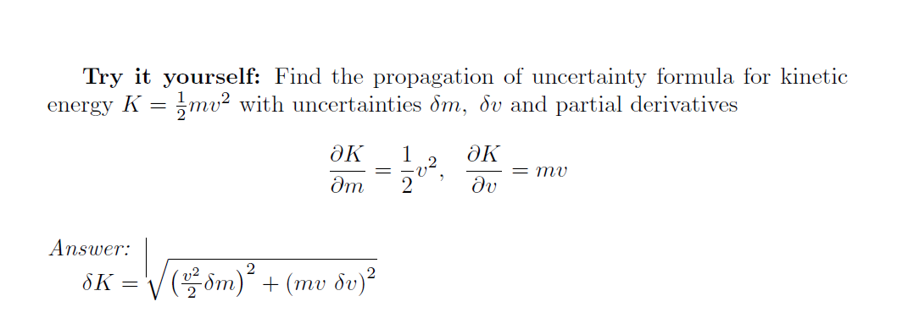
[Lab 3] Propagation of Uncertainty

Slide 10

[Lab 3] Propagation of Uncertainty

Slide 11
Questions?

Slide 12
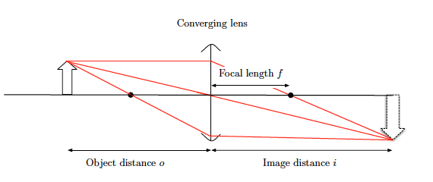
Thin Lenses

Slide 13
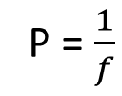
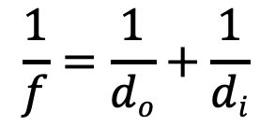
Helpful equations
Optical Power :
Optical Equation :
Optical equation goes by many names: lensmaker’s formula, thin lens equation, etc. and can use different variable symbols (p, s, o,)
P = $\frac{1}{f}$
$$\frac{1}{f}=\frac{1}{do}+\frac{1}{di}$$

Slide 14
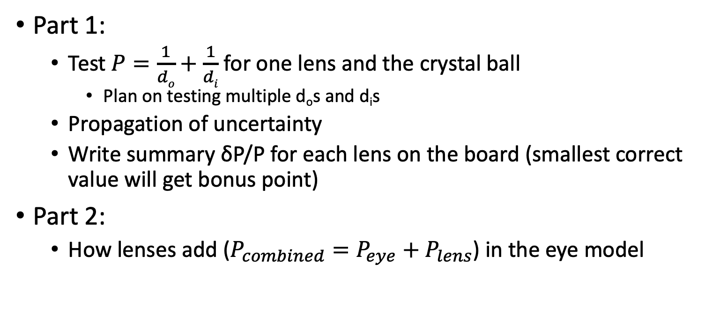
Part 1:
Test $P=\frac{1}{do}+\frac{1}{di}$ for one lens and the crystal ball
Plan on testing multiple d_{o}s and d_{i}s
Propagation of uncertainty
Write summary δP/P for each lens on the board (smallest correct value will get bonus point)
Part 2:
How lenses add ($P_{combined}=P_{eye}+P_{lens}$) in the eye model

Slide 15
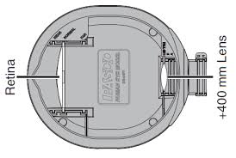

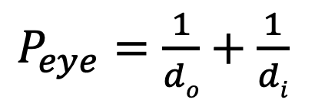
Part 2:To find $P_{eye}$
d_{i} = image distance
d_{o} = object distance
Pasco Light source
+62mm
$P_{eye}=\frac{1}{do}+\frac{1}{di}$

Slide 16
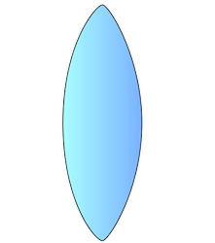
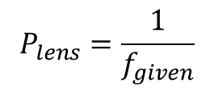
Add a corrective lens
$$f_{given}$$
d_{i} = image distance
d_{o} = object distance
Pasco Light source
+62mm
$$P_{lens}=\frac{1}{f_{given}}$$

Slide 17

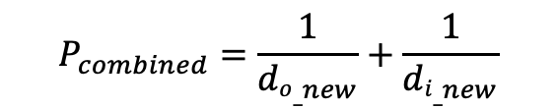

Take measurement again with corrective lens
$${di_}_{new}=image distance with corrective lens$$
Pasco Light source
$${do}_{_new}=object distance with corrective lens$$
+62mm
$$f_{given}$$
Corrective lens
$$P_{combined}=\frac{1}{{do_}_{new}}+\frac{1}{{di_}_{new}}$$

Slide 18
Extra Slides

Slide 19
[Lab 3] Propagation of Uncertainty
Plot | L | dL | W | dW | A
A | 20 | 2 | 20 | 2 | 400
B | 20 | 4 | 20 | 4 | 400
C | 20 | 6 | 20 | 2 | 400
D | 40 | 4 | 10 | 4 | 400
So, how do we determine dA?

Slide 20

[Lab 3] Propagation of Uncertainty
$$A±dA=\left(L±dL\right)∗(W±dW)$$
First Guess:
Plot | L | dL | W | dW | A
A | 20 | 2 | 20 | 2 | 400
B | 20 | 4 | 20 | 4 | 400
C | 20 | 6 | 20 | 2 | 400
D | 40 | 4 | 10 | 4 | 400
dL*dW | First Guess
4
16
12
16

Slide 21

[Lab 3] Propagation of Uncertainty
$$A±dA=\left(L±dL\right)∗(W±dW)$$
First Guess:
$$A±dA=LW±LdW±WdL±dLdW$$
Just as likely to cancel as to add!
Plot | L | dL | W | dW | A
A | 20 | 2 | 20 | 2 | 400
B | 20 | 4 | 20 | 4 | 400
C | 20 | 6 | 20 | 2 | 400
D | 40 | 4 | 10 | 4 | 400
dL*dW | First Guess
4 | dA = 84
16 | dA = 176
12 | dA = 172
16 | dA = 216

Slide 22
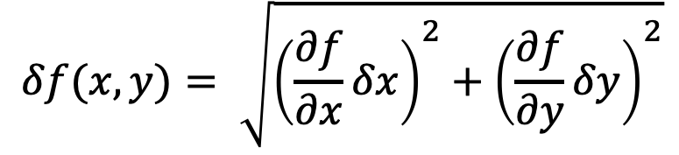
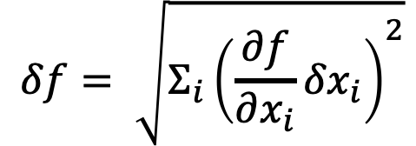
[Lab 3] Propagation of Uncertainty
Each uncertainty contributes to the total uncertainty proportional to the partial derivative (slope of f with respect to that variable)
Multiple sources don’t simply add but add “in quadrature”, since they are as likely to cancel as add
We will always give you the needed derivatives
$$δf= \sqrt{Σ_{i}{\left(\frac{∂f}{∂x_{i}}{δx}_{i}\right)}^{2}}$$
For example, if f is a function of two variables, then…
$$δf(x,y)= \sqrt{{\left(\frac{∂f}{∂x}δx\right)}^{2}+{\left(\frac{∂f}{∂y}δy\right)}^{2}}$$

Slide 23

[Lab 3] Propagation of Uncertainty
$$A±dA=\left(L±dL\right)∗(W±dW)$$
First Guess:
$$A±dA=LW±LdW±WdL±dLdW$$
Final Answer:
$$dA= \sqrt{(LdW)^{2}+(WdL)^{2}}$$
Plot | L | dL | W | dW | A
A | 20 | 2 | 20 | 2 | 400
B | 20 | 4 | 20 | 4 | 400
C | 20 | 6 | 20 | 2 | 400
D | 40 | 4 | 10 | 4 | 400
dL*dW | First Guess | Final Answer
4 | dA = 84 | ≈57
16 | dA = 176 | ≈113
12 | dA = 172 | ≈126
16 | dA = 216 | ≈165
*Remember to follow proper conventions with rounding/sig figs when reporting uncertainty.

Slide 24
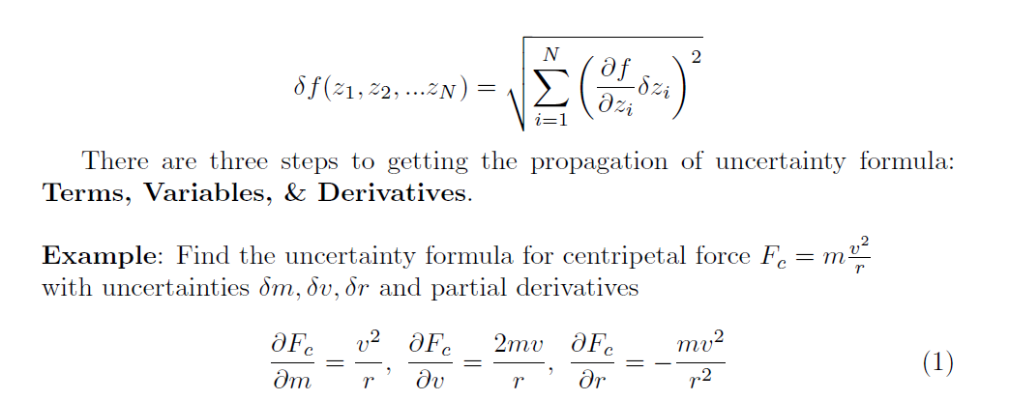
[Lab 3] Propagation of Uncertainty

Slide 25
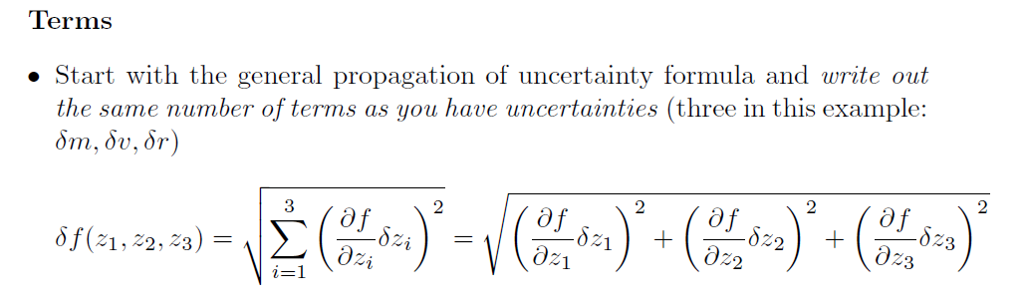
[Lab 3] Propagation of Uncertainty

Slide 26
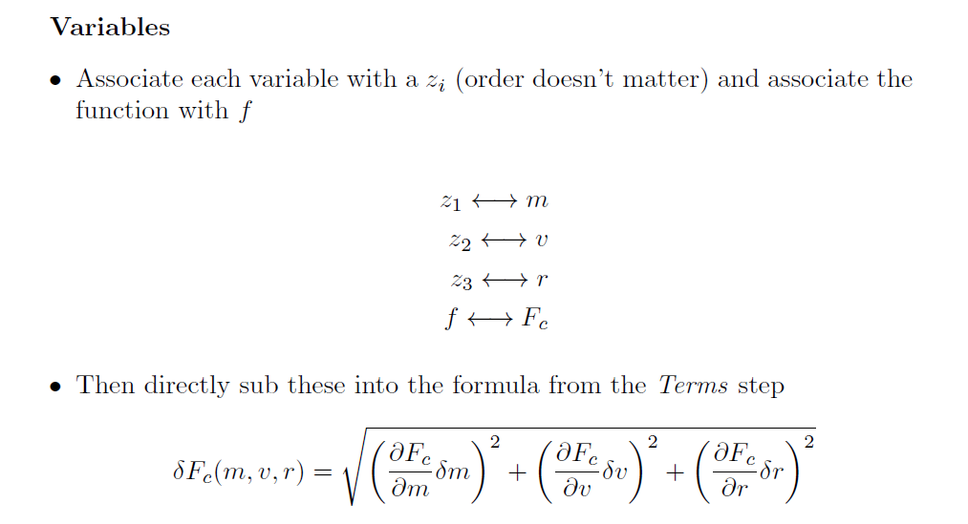
[Lab 3] Propagation of Uncertainty

Slide 27
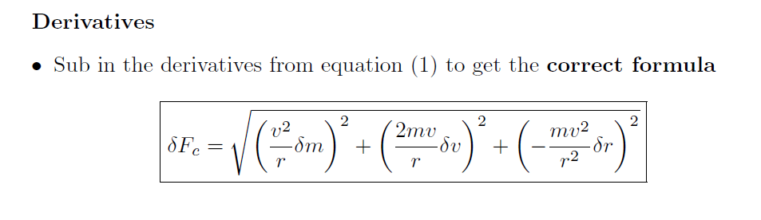
[Lab 3] Propagation of Uncertainty

